Slide 1
Student Intervention Strategies
Managing Student Discourse and Academic Language

Slide 2
Disclaimer
The information presented is not meant to be a sweeping generalization of every African-American student and their experiences
The information is based on my research and not meant to be representative of the views of the Grosse Pointe Public School System
Educators should employ various instructional strategies to improve the literacy development of African-American students. There is no silver bullet!

Slide 3
African-American Experiences
Boyz 'N The Hood
Document the images that you see
Pay particular attention to the language
Is there language particular to their environment or is it universal?
How might certain cultural experiences affect literacy?
What other sociocultural factors do you see that would have an affect on literacy development, language and socialization?
Turn and talk

Slide 4
Feedback or Discussion
Twitter:
#academicdiscourse
@i2_sing_america
Today’s Meet:
http://todaysmeet.com/academicdiscourse

Slide 5
Who Am I?
Education
Bachelor of Science in English Education, Wayne State University
Master of Education in Educational Leadership, Wayne State University
Current Doctoral Student in Curriculum & Instruction, Wayne State University
“The Usage of Teacher Professional Development to Improve the Literacy Development of African-American Males: A Sociocultural Perspective”
Work Experience
English Teacher ~ MLK HS, Detroit
English Teacher, Journalism Teacher, Forensics Coach, Yearbook Adviser ~ Renaissance HS, Detroit
Assistant Principal ~ Hamtramck HS & Farmington HS
Principal ~ Harrison HS, Farmington Hills
Director of Secondary Instruction, Grosse Pointe Public Schools

Slide 6
Discourse (D/d)
The general definition of discourse (D) is:
the formal discussion of a subject in speech or writing, as a dissertation, treatise, sermon, etc. (Surface structure)
Discourse (d) for the sake of this discussion can be defined as:
communication through spoken language, references to meanings explicit and implicit, and expectations through the use of social codes, cultures, and sub-cultures. (Deep structure)
Notes:
Lets talk about the differences between the two. How does one affect the other and what does this have to do with academic achievement?
When two people are having a conversation, they are engaging in discourse (d). Beneath that, there is a different type of discourse (D). D is a bigger type of discourse because this is where meaning, cultural assumptions, and codes are attached.

Slide 7
Discourse (D/d)
Discourse ‘D’
Example: “Good morning! How are you? It is nice to see you today.”
Discourse ‘d’
Example: Lyrics from Jay-Z
“Two seats in the 911…No limit on the black card…I told you I was gon’ go H.A.M. … ‘til the ocean was my backyard.”

Slide 8
Discourse (D/d)
How would you interpret a message in discourse ‘d’?
What factors need to be present for one to gain meaning from language? Text?

Slide 9
School vs. Home Language
Define the following words, topics, or phrases:
Cake
“Low Key”
“What’s good?”
“It’s a wrap”
Swag or Swagger
I’m on ten

Slide 10
School vs. Home Language
Contextual understanding
What provides context?
John is always caking with his girlfriend!
Low key, the new J’s are on sale at Foot Locker.
What’s up Jay, what’s good?
Low key, if I get up in class and the sub is trippin, it’s a wrap! Imma be on ten!
Stop tryin’ to front on my swag…you know I’m fresh!

Slide 11
School vs. Home Language
Define the following words, topics, or phrases:
Cake – To kiss or smooch ☺
“Low Key” – A fact that is unbeknownst to many
“What’s good?” – How are you doing?
“It’s a wrap” – Its over (usually referring to someone being upset with something and they don’t want to deal with it any more)
Swag or Swagger – Panache, style, or flair
I’m on ten – A person that gets upset about something immediately

Slide 12
School vs. Home Language
Define the following words, topics, or phrases:
Precipitate
Regatta
Juxtapose
Infer
Please provide your hypothesis
Analyze or Analysis
Literal vs. figurative
Process (verb)
Think out loud
Notes:
Let’s take a look at some of the academic language we use. What do these mean?
This is not just about African American students; however, Af. Am. Student struggle the most with this. Every student must develop multiple literacies to be able to engage with content. However, many students’ home language aligns with school or academic language.
Its no secret and the data shows us that there is a direct co-relation with race, socio-economic status, and educational attainment OR what we refer to as academic achievement

Slide 13
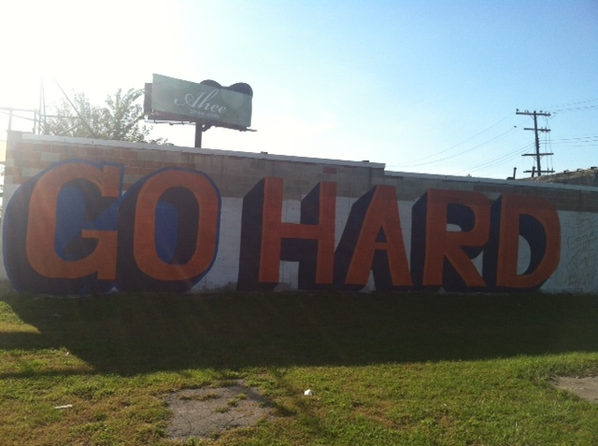
Academic Language “Go Hard”
What does this mean?
It this acceptable language? Why or why not?

Slide 14
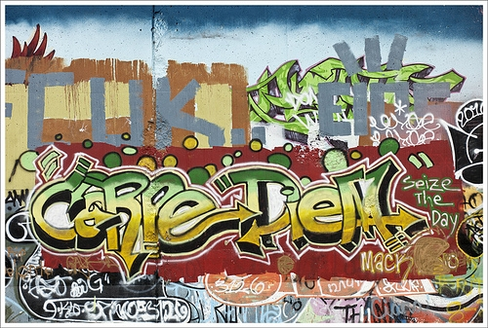
Academic Language “Carpe Diem"
What does this mean?
It this acceptable language? Why or why not?
What is the difference from the previous slide?

Slide 15
The Case for Building Academic Language
On average students score within the 83rd percentile on standardized tests when they receive direct vocabulary instruction. Students who do not receive direct vocabulary instruction score within the 50th percentile
Instruction that focuses on building academic language in students has a .97 effect size
(Marzano & Pickering, 2005)
Notes:
Explain mean, effect size, and standard deviation

Slide 16
Strategies to Increase Academic Discourse
Build Word Walls or Provide Vocab. Lists
Providing a list of expected and anticipated language to be used in class is the first step in building academic vocabulary and discourse. This should be done across ALL subject areas (Vocab. Lists for each subject areas have been emailed to you).
A decontextualized word study should be avoided, because it makes students simply memorize words without giving them a sense of the words’ significance (Tatum 2002)

Slide 17
Strategies to Increase Academic Discourse
Conduct frontloading activities or pre-reading
Bridge Texts
Use shorter texts to introduce important or difficult topics or themes
Use compelling stories or current events
Use concept maps to increase comprehension of vocab., themes, or concepts.
Find students’ interests and make materials relevant to their lives. Acknowledge and value their home discourse to get them interested in school discourse.
Notes:
Bridget Texts
Discuss options of using articles about chemical warfare in apartheid South Africa and how chemistry (science) was used for a bad purpose. Use that to highlight the good purposes of science.
Concept Maps
Talk about usage of concept maps to talk about theme, words, vocab. Use example of love how examples of love is shown in Romeo and Juliet as compared to Beloved

Slide 18
Competence and Socialization
How do outside variables affect students’ access and attainment?

Slide 19
Competence and Socialization
To be a successful student, one must demonstrate knowledge of standards for participation as well as knowledge of academic content relevant to the moment (Cazden, 1988)
Students must understand the intertextual and the historical nature of the competence created through the understanding of meaning (explicit and implicit). Students who do not develop such competence are excluded from other related events in academic settings (Bloome & Bailey 1992)

Slide 20
Competence and Socialization
Brian and the Spelling Bee
Brian and the Spelling Bee
What issues did Brian experience?
What did the teacher do?

Slide 21
Competence and Socialization
Some students have multiple identities and sometimes conflicting identities within the culture of a classroom. This causes some students to reject the dominant or school-based culture and/or discourse (Lewis 2001)
Enciso and Moje (????) urge educators to help students who do not come from the dominate culture to move through transcultural spaces.
Skills and strategies are only working tools; they have little utility for advancing students’ {academic achievement}. They are similar to providing a student with a hammer and nails: simply giving someone a hammer and nails does not mean that the person will come up with the idea of building a house (Tatum 2005)

Slide 22
Competence and Socialization
Social Codes
What social codes do you expect students to possess when they enter your classroom for the first time?
Appropriate language?
Appropriate volume and tone?
To use language in the proper context as it relates to content?
To adhere to dominant social codes accepted by society?
To be able to read and discuss content?
To be engaged?
Have appropriate social codes been taught? Should they be taught?
Notes:
What are some of the things that you have come to expect as being appropriate social behavior when students are in school?
Turn and talk to your neighbor
Have those or should those be taught?

Slide 23
Competence and Socialization
Social expectations are related to the beliefs, codes, and norms for action and interaction promoted within the classroom. Interpretive expectations are those related to the reading, understanding, and discussion of {content}. (Lewis 2001)
Why is socialization important?
Increases social competence of the students in the class
It teaches students to work with others rather than be isolated
It teaches students to value learning from others
It teaches students students to think critically and set goals toward positive action
It teaches students to appreciate human connection and collective history

Slide 24
Competence and Socialization
Code Switching
To preserve their home or primary culture, some students have to learn to “Code Switch”
Code Switching refers to being able to speak multiple discourses and knowing when to apply the right discourse in the right setting.
Students (especially African American students) will reject a dominant cultural code if it conflicts with their home culture.
Notes:
Use example about girlfriend from Boston

Slide 25
Competence and Socialization
Article about President Obama Code Switching
President Obama and Code Switching
Senate majority leader, Harry Reid, observed that Mr. Obama spoke “with no NEGRO dialect, unless he wanted to have one.” Obama minus the "Negro" dialect
President Obama at Ben’s Chilli Bowl in Washington, DC President Obama at Ben's Chilli Bowl
President Obama accepting nomination at DNC President Obama at DNC
Turn and talk
What are the differences in the president’s language?
Why did he change it?

Slide 26
Strategies to Help Improve Socialization
Create a warm classroom environment
Make your class room socially equitable and culturally competent.
Take an interest in students as people. Get to know them. Share some information about yourself.
Hone your listening skills
85% of listening is non-verbal. Pay attention with your body and facial language
Do not interrupt or place values on things that students say.
Reflect on what students have to say by paraphrasing and verbalizing it back to them.
Notes:
Competent is the very minimum set of knowledge and skills one could have about a topic or area
Refer to Move Cards

Slide 27
Strategies to Help Improve Socialization
Classroom environment (continued)
Develop Classroom Cultural Rituals
Model critical thinking skills and what it is like to be intellectually curious
This should become a common expectation in your class
Read-alouds
Higher-order thinking questioning techniques
Opportunities for students to participate socially and navigate different social structures (eg. Gender, racial, socio-economic)
Place students in reading groups, lab groups, and collaborative work-groups
Set that expectation that some time during the course of their group work, each student will have the opportunity to be the “expert” on something.

Slide 28
Strategies to Build Interpretive Competence
Build interpretive competence
Help students understand their contributions in a historical and cultural context.
Make connections to their worlds (music, other books, the larger culture)
Make your thinking visible but resist presenting it as the “right” idea
Have students journal their experiences with the content to have them participate in the process of metacognition
Participate frequently in conversations around multiple social discourses as it relates to the content

Slide 29
Questions to Ponder
Do you view critical social awareness as an essential function of schooling?
How important is competence in multiple discourses in your classroom? To your content?
What are the implications of socialization on building academic vocabulary?

